Slide 1

Normalization vs. Denormalization
TOPS TECHNOLOGIES
Submitted by:- Ruchit Thummar

Slide 2
OUTLINE
Normalization
Denormalization
Advantages
Disadvantages
Real world examples

Slide 3
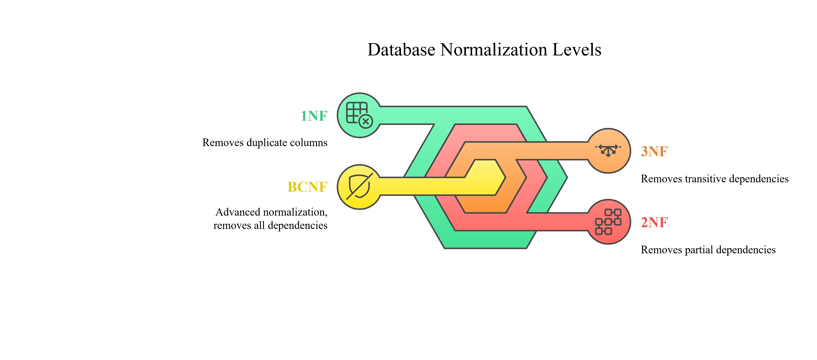
What is Normalization?
Normalization is a method used in databases to remove repeated data (called redundancy) and to keep the data accurate and consistent.
It organizes the data in a proper way so that there is no extra or duplicate data.

Slide 4
1NF(Normal Form):-
each column should have only single, atomic (indivisible) values.
Each column should store only one value (no lists or commas).
Each row must be unique.
Example:-
sid | name | subjects
1 | Alice | Mathematics, Physics
2 | Bob | Chemistry, Biology
sid | name | subjects
1 | Alice | Mathematics
1 | Alice | Physics
2 | Bob | Chemistry
2 | Bob | Biology
(Using 1NF)

Slide 5
2NF(Normal Form):-
It must be in 1NF and all non-key attributes are fully dependent on the primary key.
What is Partial Dependency?
If a table has a composite primary key (made of two or more columns), and a column depends on only one part, that's partial dependency.
Example:-
Student Table
Sid | Sname
1 | Alice
2 | Bob
sid | Courseid | Sname | Cname
1 | 101 | Alice | Mathematics
2 | 102 | Bob | Physics
Using 2NF
Course Table
Courseid | Cname
101 | Mathematics
102 | Physics

Slide 6
3NF(Normal Form):-
It must be in a 2NF and no transitive dependency.
What is transitive Dependency?
Every non-key column should depend only on the primary key, not on another non-key column.
Example:-
Eid | Name | Deptid | Deptname
1 | Alice | D01 | Sales
2 | Bob | D02 | Hr
Employee Table
Eid | Name | Deptid
1 | Alice | D01
2 | Bob | D02
Using 3NF
Department Table
Deptid | Deptname
D01 | Sales
D02 | Hr

Slide 7
BCNF(Boyce-Codd normal form):-
It must be in a 3NF every functional dependency (x->y), x is super key .
What is functional Dependency?
If you know the value of column A, you can uniquely determine the value of column B
Example:-
Couse Table
Course | Instructor
Math | Alice
Math | Bob
Physics | Alice
Course | Instructor | Room
Math | Alice | 101
Math | Bob | 101
Physics | Alice | 102
Using BCNF
Instructor Table
Instructor | Room
Alice | 102
Bob | 101

Slide 8
What is Denormalization?
Denormalization is the opposite of normalization.
It means combining tables to reduce the number of joins and improve read performance.
Example:-
SQL Query:-
SELECT Name, City_Name
FROM Customers c
JOIN City ct
ON c.City_ID = ct.City_ID;

Slide 9
Customer Table
Cust_ID | Name | City_ID
1 | Alice | 101
2 | Bob | 102
City Table
City_ID | City_Name
101 | USA
102 | UK
+
Cust_ID | Name | City_ID | City_Name
1 | Alice | 101 | USA
2 | Bob | 102 | UK
=

Slide 10
Normalization Advantages & Disadvantages
Advantages:-
Removes data redundancy by avoiding repeated values.
Ensures data consistency across the whole database.
Saves storage space by removing duplicate data.
Prevents insert, update, and delete anomalies.
Disadvantages:-
Requires complex joins to fetch related data.
Can slow down queries due to multiple table lookups.
Increases database design complexity for beginners.
Harder to write queries for large normalized databases.
Denormalization may be needed later for faster reports.

Slide 11
Denormalization Advantages & Disadvantages
Advantages:-
Speeds up queries by reducing the need for joins.
Improves performance in reporting and analytics.
Simplifies SQL queries with fewer tables involved.
Keeps all related data in a single, easy-to-access table.
Disadvantages:-
It Causes data redundancy by repeating values.
It Increases risk of inconsistent data during updates.
It Uses more storage space due to duplication.
It Makes data harder to maintain and clean.

Slide 12
Normalization real world examples
Normalization:-
Example 1:-
Banking Systems:- Every customer’s data (personal, account, transactions) is stored in separate related tables.
It helps maintain accuracy, avoid data duplication, and ensure security.
Example Tables: Customers, Accounts, Transactions, Branches
Example 2:-
Hospital Management System:- Patient info, doctor details, appointments, prescriptions – all in different normalized tables.
It reduces errors and makes data easy to maintain.
It ensures a patient's name isn't repeated in every appointment row.

Slide 13
Denormalization real world examples
Denormalization:-
Example 1:-
E-Commerce Dashboards:- For quick reporting, product info, customer, and order details are stored together in one big table.
Fast to generate daily sales reports.
It used in dashboards like admin panels of Amazon, Flipkart, etc.
Example 2:-
Streaming Services:- User watch history, video info, and preferences are stored together.
Allows quick recommendations and personalized feeds.

Slide 14
THANK YOU

